Slide 1
AP Stats CH 1 and 2 Review

Slide 2
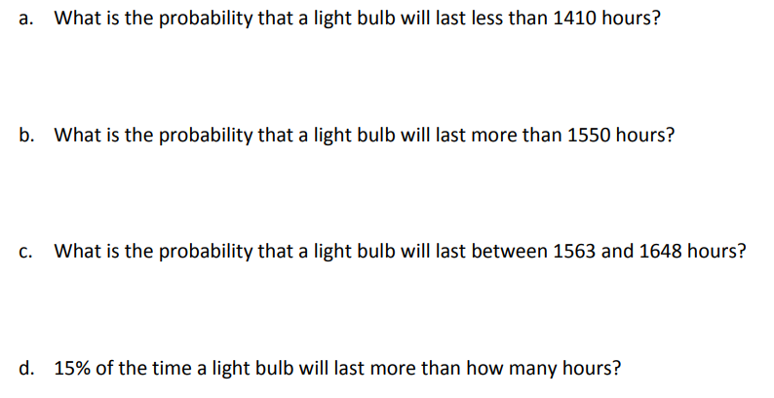

Slide 3
11.51% of the particular brand of light bulb will last less than 1410 hours
50% of the particular brand of light bulb will last more than 1550 hours
17.6% of the particular brand of light bulb will last between 1563 to 1648 hours
15% of the time a light bulb will last more than 1577.73 hours

Slide 4
This is the z-score for a LEFT area of 5%
The new mean would be 1323.36 hours
The new std dev would be 182.387 hours

Slide 5
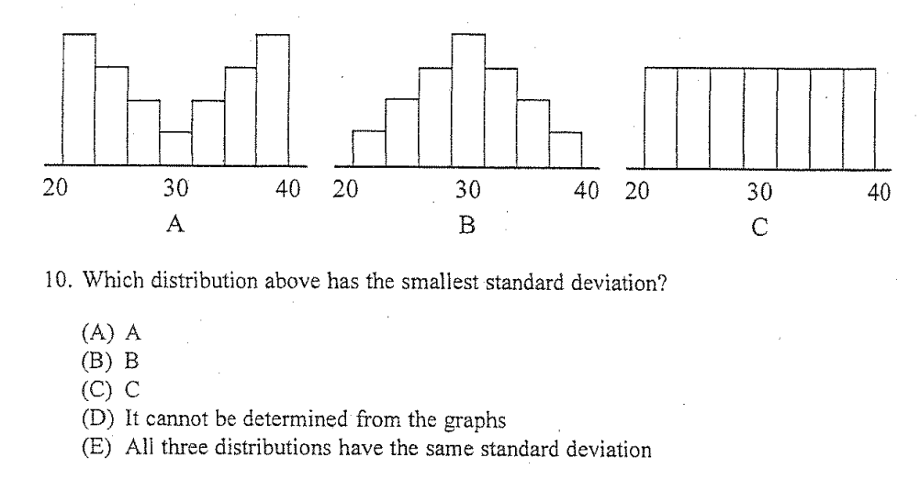
Distribution “B” b/c compared to the other distribution it had the largest amount of data centered around the mean

Slide 6
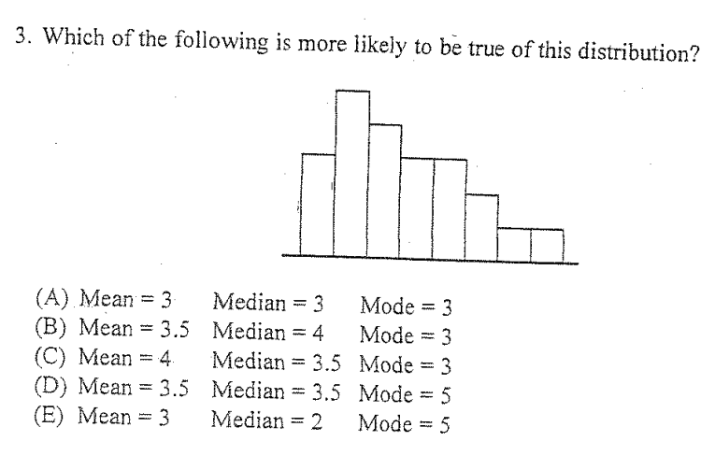
MEDIAN
With the data skewed right, the mean would be greater than the median
MODE
MEAN
MEAN > MEDIAN > MODE
Answer is “C”

Slide 7
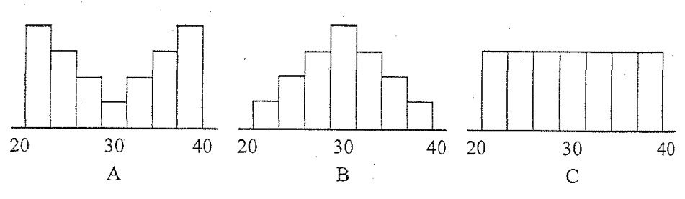
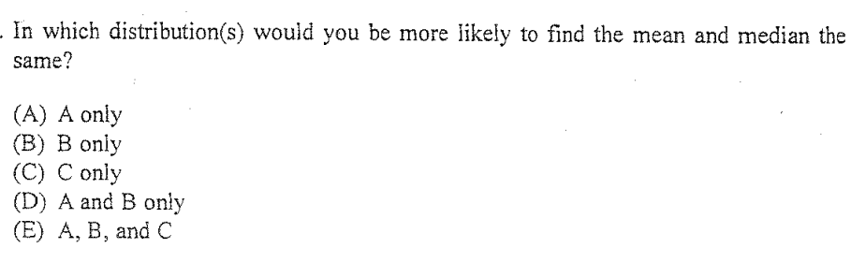
“E”

Slide 8
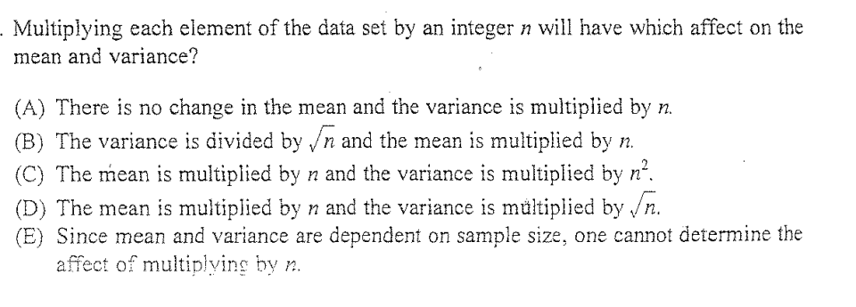
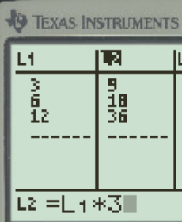
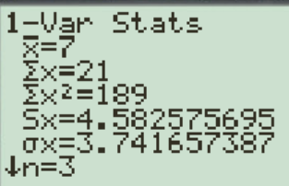
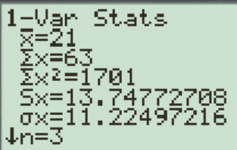
If you don’t know how to do this, mean a random list in L1 and then set L2 as L1 x 3
Then do a 1-var calc of each list to compare then mean and variance…..
With n = 3, the mean is 3 times larger
The variance is 9 times larger
ANSWER “C”

Slide 9
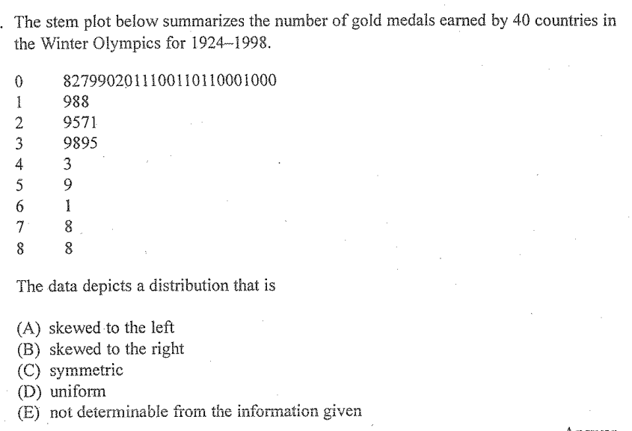
Tail is on the larger end of the data set. The distribution is skewed to the right

Slide 10
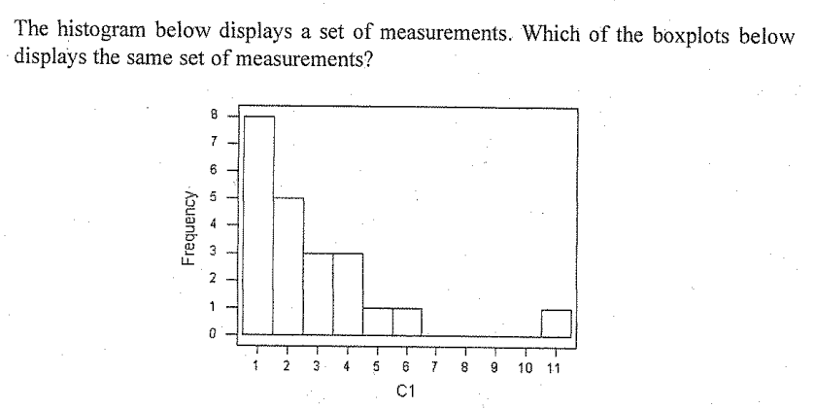
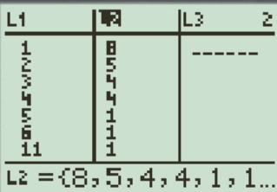
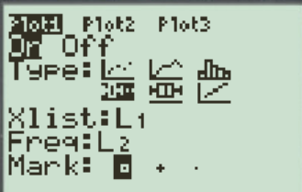
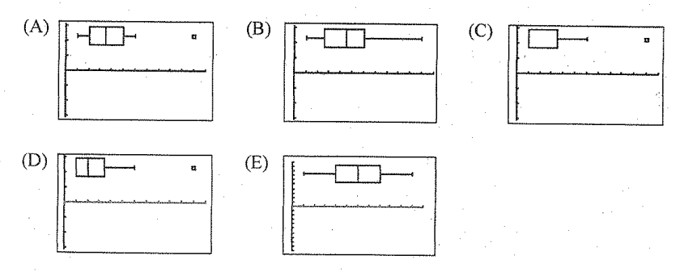
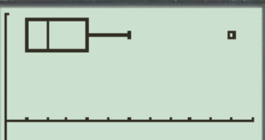
Just to be completely sure, I typed this data on calculator using L 1 and L2
TO save time, I would use the calculator to create my boxplot…
ANSWER “D”

Slide 11
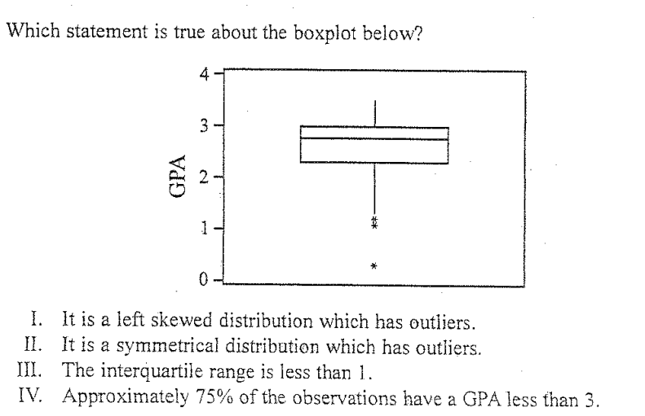

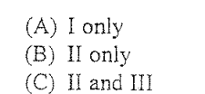
Distribution is skewed left
Distribution is NOT symmetrical
IQR is less than 1 [Q1: 2.2 Q3: 3]
Q3 is at GPA of 3. So 75% of data point is less than GPA of 3
Answer is “E”

Slide 12
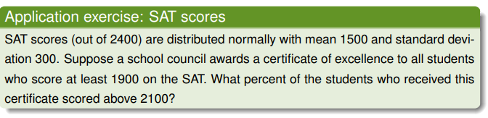
The numerator includes everyone that scored 2100 or higher
Around 25% of all certificate receivers got a score of 2100 or higher
The denominator includes everyone that received a certificate b/c they scored 1900 or higher

Slide 13
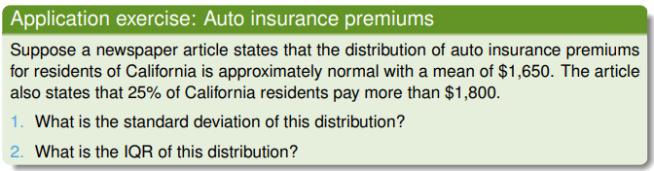
This is the z-score that corresponds with the 75th percentile. It also corresponds with the insurance premium of $1800
The standard deviation is $222.39

Slide 14
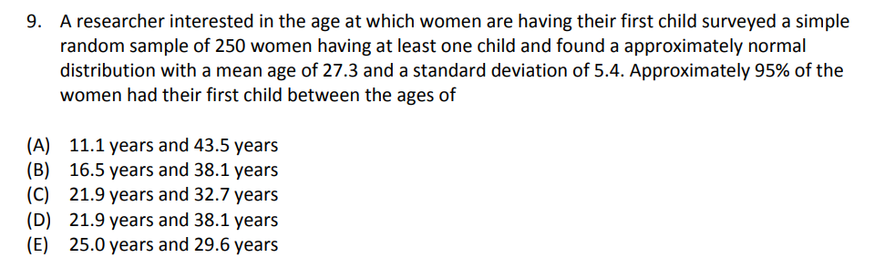
Going up 2 std deviations and down 2 standard deviations from the mean will give us an area of 95%
ANSWER “B”

Slide 15
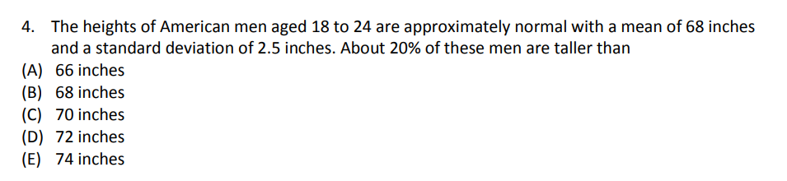
ANSWER “C”

Slide 16
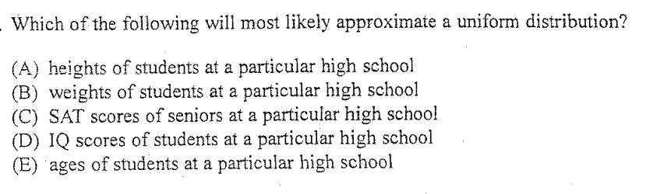
ANSWER “E”

Slide 17
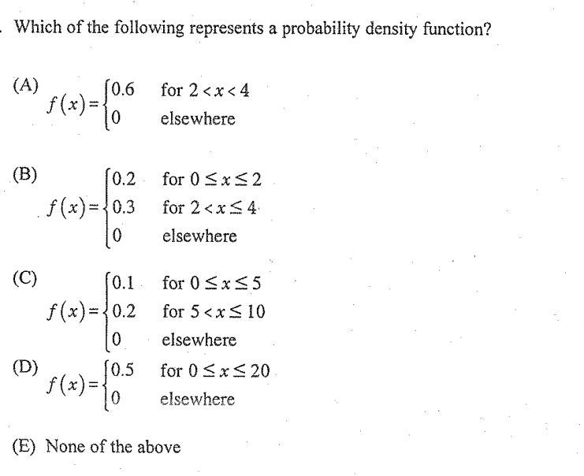
ANSWER “B”, it’s the only choice where the total area is 1.00

Slide 18
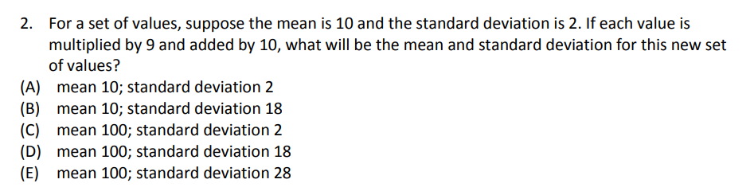
The new Mean = 10 x 9 + 10 = 100
The new variance = 4 x 9
The new std dev =6
Ooops, none of the choices work….

Slide 19
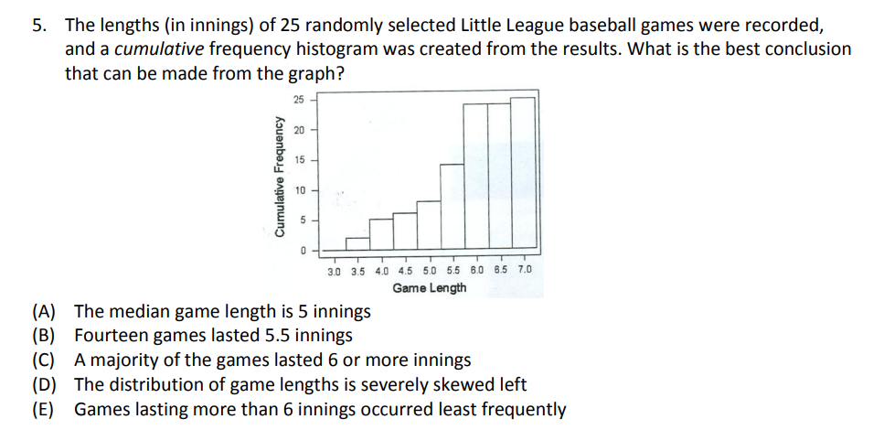
ANSWER “E”

Slide 20
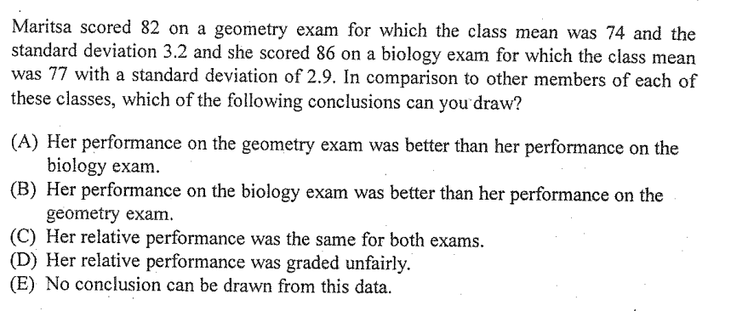
Find the “z” score for each class
Geometry vs Biology
Her “z” score is higher in the biology exam. Answer “B”

Slide 21
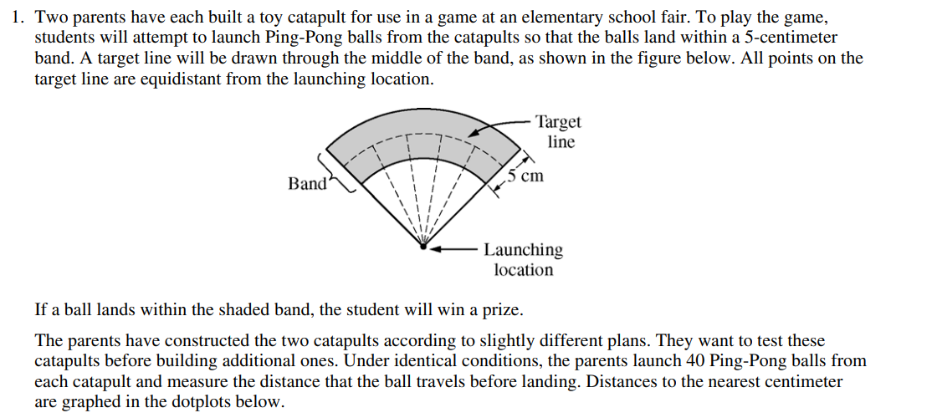

Slide 22
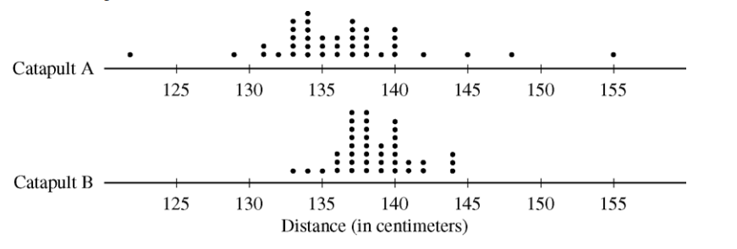
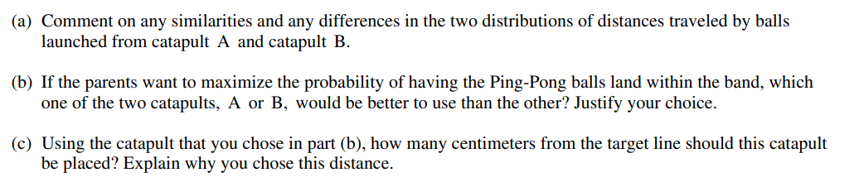

Slide 23
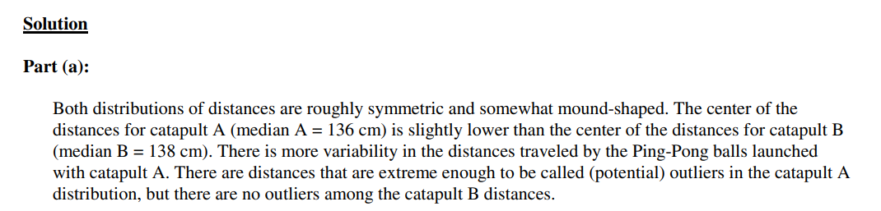

Slide 24
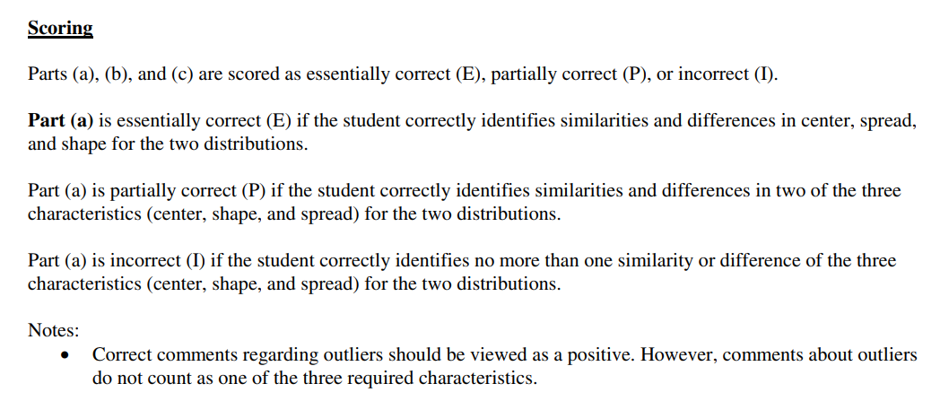
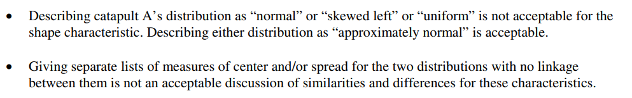

Slide 25
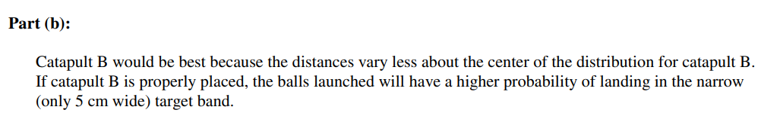
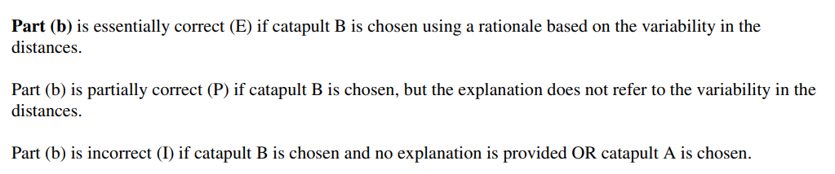
SOLUTION
Scoring

Slide 26
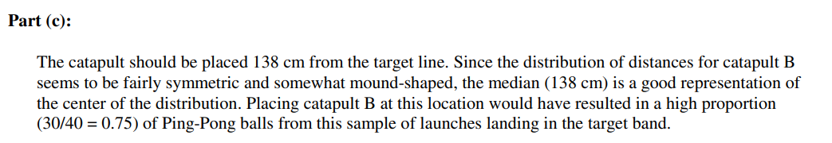
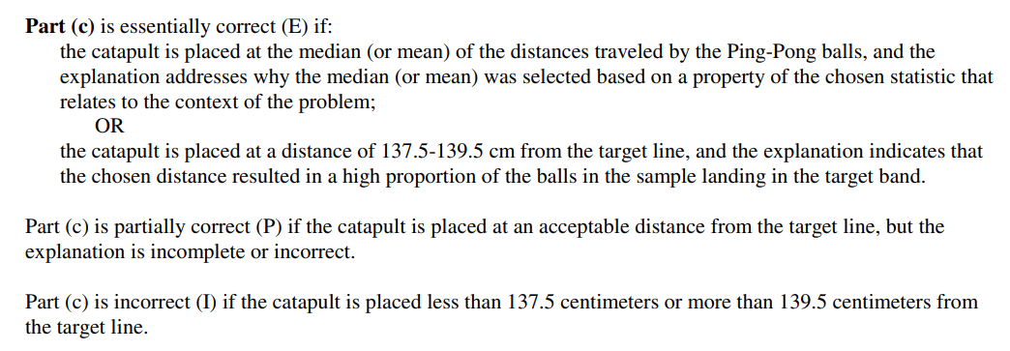
SOLUTION
Scoring

Slide 27
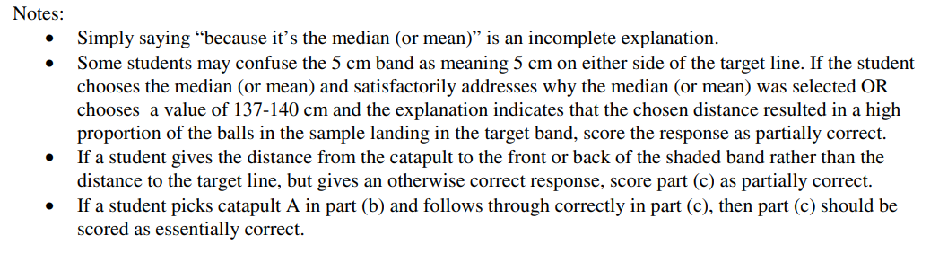
Important notes!!! Read THIS PART!!!

Slide 28
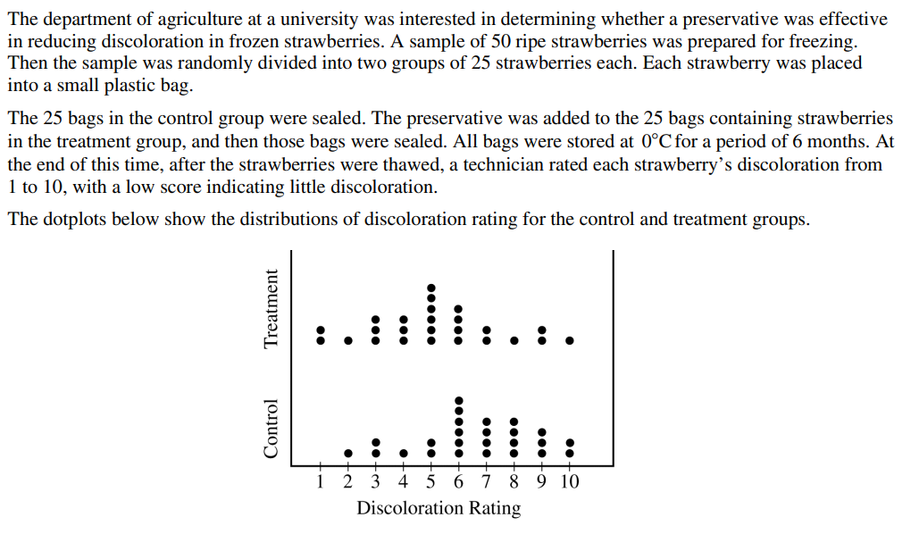

Slide 29
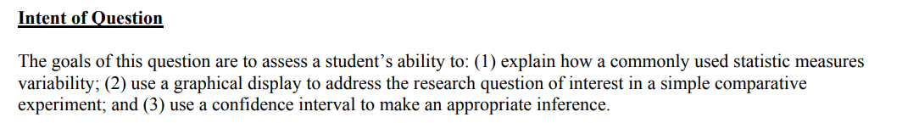
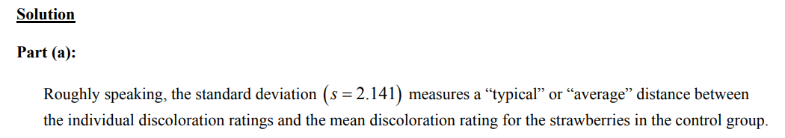

Slide 30
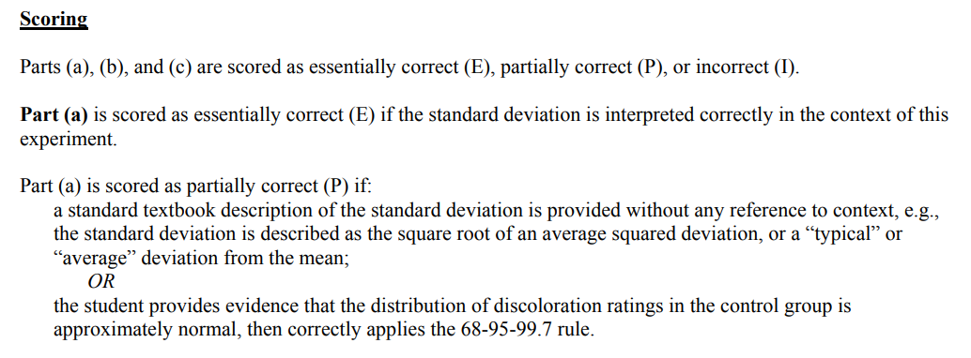
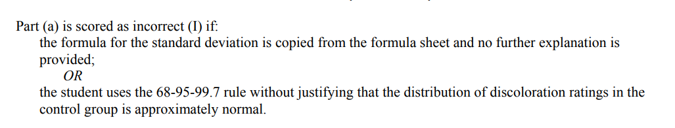

Slide 31
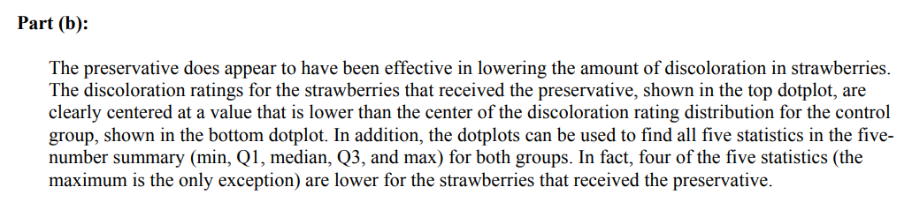
SOLUTION

Slide 32
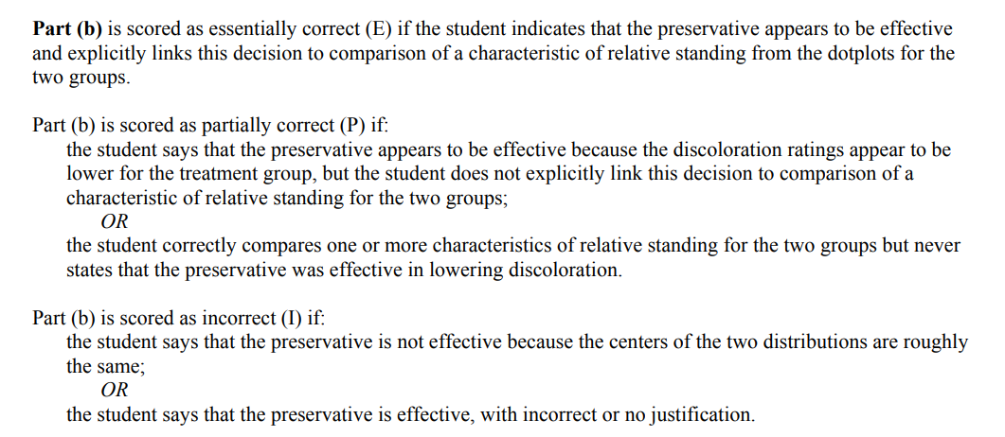
Scoring

Slide 33
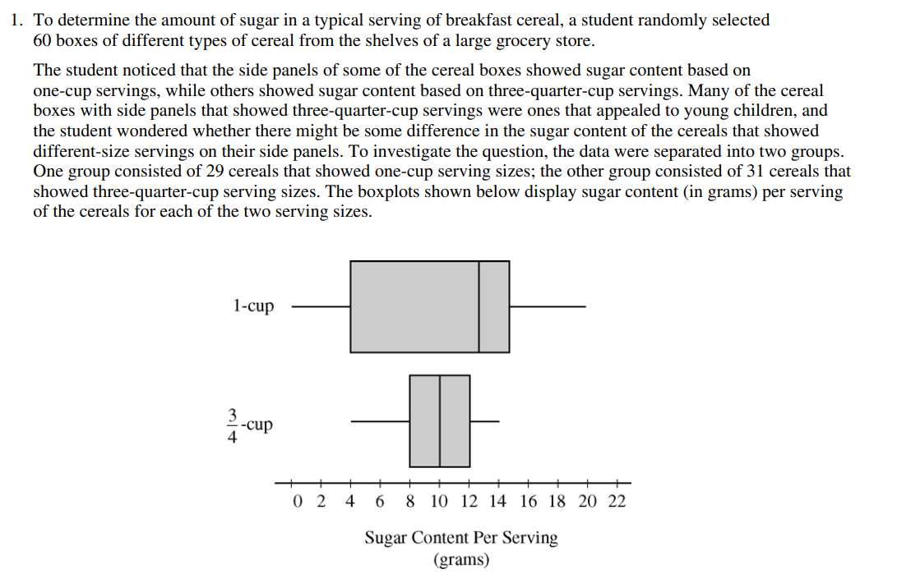

Slide 34
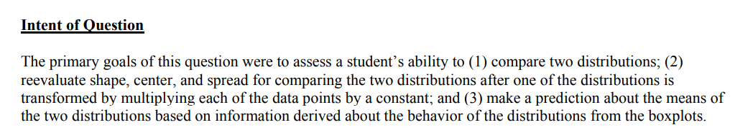
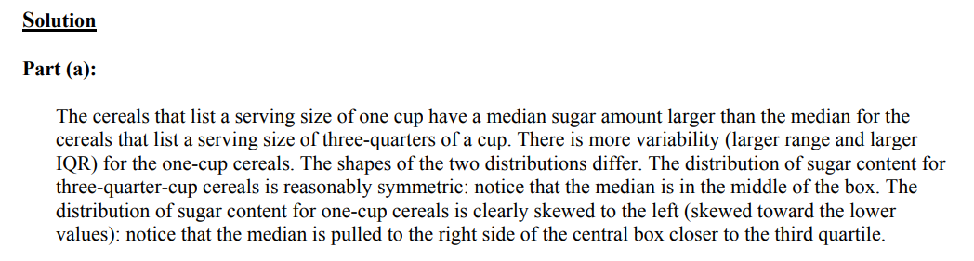

Slide 35
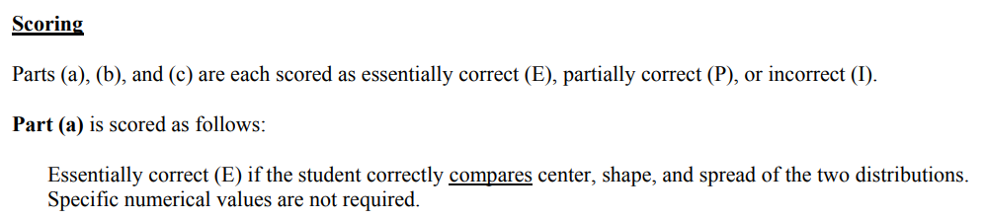
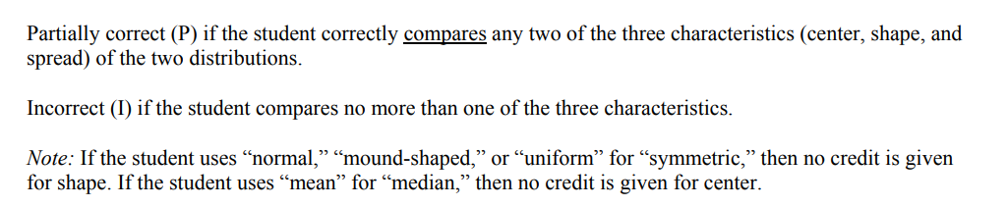

Slide 36
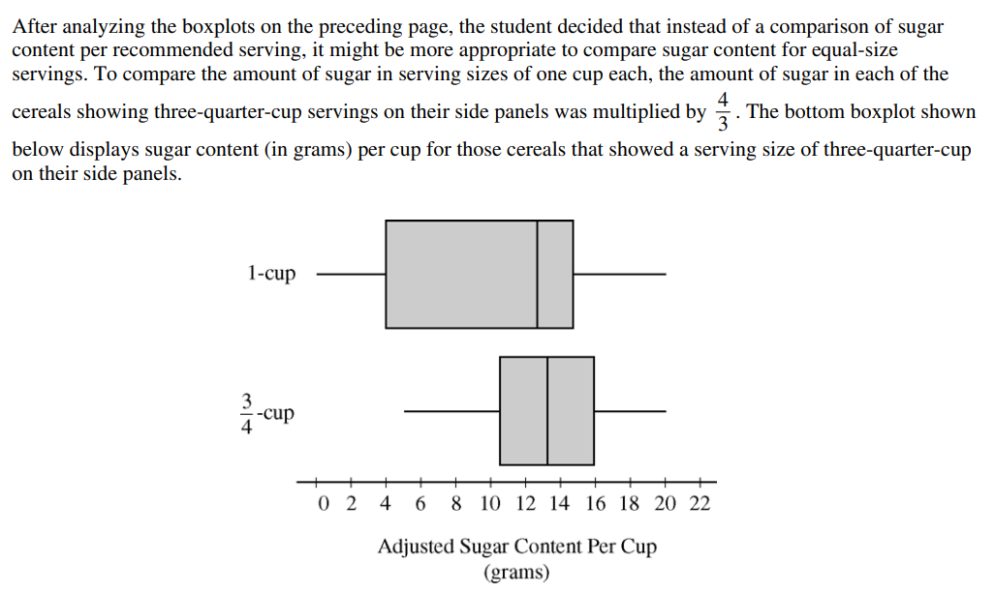

Slide 37


SOLUTION
Scoring

Slide 38

SOLUTION

Slide 39

Scoring

